Slide 1
Subject Verb Agreement, Tenses, Articles & Parts Of Speech
2025

Slide 2
Subject Verb Agreement

Slide 3
The term ‘subject-verb agreement’, just like the name suggests, refers to the agreement between the subject and the verb. This is mainly with reference to singular and plural nouns/pronouns that act as subjects. The general rule of subject-verb agreement according to Garner’s Modern English Usage is “to use a plural verb with a plural subject, a singular verb with a singular subject.

Slide 4
Rules Of Subject Verb Agreement
Rule 1
The first rule is what we have already discussed – the use of a singular verb with a singular subject and a plural verb with a plural subject. The subject can be a noun, a pronoun .
Ex:He Plays Cricket.
Rule 2
The use of ‘have’ and ‘has’ in the present perfect tense, the present perfect continuous tense and as a main verb is also dependent on the subject. All singular subjects use ‘has’ and all plural subjects use ‘have’.
Ex: Swetha has a pet dog.

Slide 5
Rule 3
Subjects combined using the conjunction ‘and’ take a plural verb.
Ex: Krish and Radha are on their way to the airport.
Rule 4
When more than one noun is joined by the conjunction ‘or’, the subject is
considered to be singular and a singular verb is used.
Ex: Your mom or dad has to be here in an hour.

Slide 6
Rule 5
Sentences with pronouns such as anybody, anyone, no one, somebody, someone,
everybody, everyone, nothing and nobody are treated as singular subjects and will
therefore use a singular verb.
Ex: Everyone was happy with the outcome.
Rule 6
For sentences using ‘either..or’ and ‘neither..nor’, the verb should agree with the noun
or pronoun that comes just before it.
Ex:
Neither Ricky nor Gina is here yet.
Neither the children nor their parents are aware of the consequences.

Slide 7
Rule 7
When the subject refers to a period of time, distance or a sum of money, use a
singular verb.
Ex: 1267 kilometres is too long for us to travel in half a day.
Rule 8
When a sentence begins with ‘each’ or ‘every’ as the subject, it is considered
singular and so the verb has to be singular too.
Ex: Each student has been asked to provide a consent letter.

Slide 8
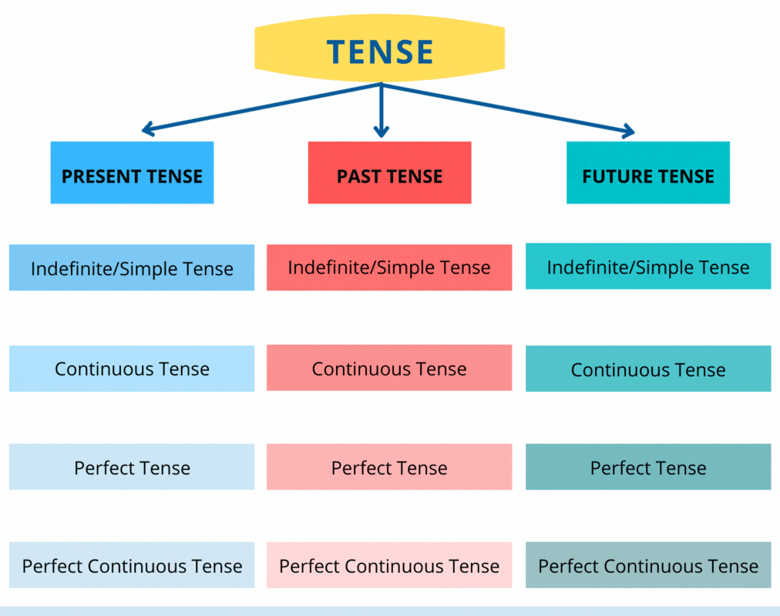
TENSES

Slide 9
Present Tense
Present Tense can be defined as an expression for an activity that is currently in action or
is habitually performed. It is used for a state that generally exists or is currently ongoing.
i)Simple Present
Rule: Subject + V1 + Object
Ex: She eats food.
ii)Present Continuous
Rule: Subject + is/am/are + V1 + ing + object
Ex: She is eating food.

Slide 10
iii)Present perfect
Rule: Subject + has/have + V3 + Object
Ex: She has eaten food.
iv)Present perfect continuous
Rule: Subject + has/have + V3 +ing+ Object
Ex: She has been eating food since morning.

Slide 11
Past Tense
Any event or action that took place in the past can be referred to as the past tense.
i)Simple Past
Rule: Subject+v2+object
Ex: She wrote homework.
ii)Past Continuous
Rule: Subject+was/were+v1+ing+object
Ex: She was writing Homework

Slide 12
iii)Past Perfect Tense
Rule:Sub+had+v3+object
Ex: She had written homework.
iv)Past perfect continuous tense
Rule: Sub+had been+v1+ing+object
Ex: She had been writing homework for two months.

Slide 13
Future Tense
The actions that are to take place in the future fall in the category of the future tense.
i)Simple future
Rule: Sub+will/shall+ v1+object
Ex: She will go to school tomorrow.
ii)Future Continuous
Rule: Sub + will/shall + be+v1+ing+object
Ex: She will be going to school tomorrow.

Slide 14
iii)Future Perfect
Rule: Subject + will have/shall have + V3 + Object
Ex: She will have gone to school tomorrow.
iv)Future Perfect Continuous
Rule: Sub+ will have/shall have +been +v1+ing+object
Ex: She will have been going to school tomorrow

Slide 15
Divider title will go here on one or two lines in Arial 36pt bold

Slide 16
Basic title and content - light
1st level text
2nd level text
3rd level text

Slide 17
Title, super head, subhead and footnote - light
Super head
Subhead
1st level text
2nd level text
3rd level text
Insert source or footnote here

Slide 18
Title only - light

Slide 19
Blank

Slide 20
Two content
1st level text
2nd level text
1st level text
2nd level text

Slide 21
Two column - light
Subtitle
Subtitle
1st level text
2nd level text
1st level text
2nd level text

Slide 22
Three column - light
Subtitle
Subtitle
Subtitle
1st level text
2nd level text
1st level text
2nd level text
1st level text
2nd level text

Slide 23
Comparison horizontal - light
Subtitle
1st level text
2nd level text
Subtitle
1st level text
2nd level text
Subtitle
1st level text
2nd level text

Slide 24
Content with caption
Subtitle
1st level text
2nd level text

Slide 25

Picture with caption
Subtitle

Slide 26
Statement or quote will go here in Arial 36pt bold
Attributor name is 16pt Arial

Slide 27
Click to add big statement

Slide 28
Basic title and content - dark
1st level text
2nd level text

Slide 29
Title, super head, subhead and footnote - dark
Super head
Subhead
1st level text
2nd level text
Insert source or footnote here

Slide 30
Title only - dark

Slide 31
Blank - dark

Slide 32
Two content - dark
1st level text
2nd level text
1st level text
2nd level text

Slide 33
Two column - dark
Subtitle here
Subtitle here
1st level text
2nd level text
1st level text
2nd level text

Slide 34
Three column - dark
Subtitle
Subtitle
Subtitle
1st level text
2nd level text
1st level text
2nd level text
1st level text
2nd level text

Slide 35
Comparison horizontal - dark
Subtitle
1st level text
2nd level text
Subtitle
1st level text
2nd level text
Subtitle
1st level text
2nd level text
Insert source or footnote here

Slide 36
Content with caption
Subtitle
1st level text
2nd level text

Slide 37
Picture with caption
Subtitle

Slide 38
Statement or quote will go here in Arial 36pt bold
Attributor name is 16pt Arial

Slide 39
Click to add big statement

Slide 40
Full bleed image

Slide 41
Two full bleed images

Slide 42
Half-image
1st level text
2nd level text

Slide 43
Half-image - dark
1st level text
2nd level text

Slide 44

Charts - column
Vertical bars 1 on light
Vertical bars 1 on dark

Slide 45
Charts - stacked column
Vertical stacked bars on light
Vertical stacked bars on dark
Series 3
Series 3
Series 2
Series 2
Series 1
Series 1

Slide 46
Charts - bar
Horizontal bars on light
Horizontal bars on dark
Vertical bars 2 on light
Vertical bars 2 on dark

Slide 47
Charts - donut
One data point on light
One data point on dark
60%
Category
60%
Category
Two data points on light
Two data points on dark
40% Category
Topic
60% Category
40% Category
Topic
60% Category

Slide 48
Charts - donut, multiple categories
Multiple data points on light
Multiple data points on dark
Category
Category
Category
Category
Category
Category
Category
Category

Slide 49
Charts - pie
One data point on light
One data point on dark
60%
Category
60%
Category
Two data points on light
Two data points on dark
40% Category
60% Category
40% Category
60% Category

Slide 50
Charts - pie, multiple categories
Multiple data points on light
Multiple data points on dark
Category
Category
Category
Category
Category
Category
Category
Category

Slide 51
Charts - line
Line chart on light
Line chart on dark

Slide 52
Charts - stacked area
Stacked area chart on light
Stacked area chart on dark
Series 3
Series 3
Series 2
Series 2
Series 1
Series 1

Slide 53
Basic table (PowerPoint default style)
Note: when inserting a table, this is the default style. Reformat to preferred Cognizant style under the Table Design tab. Uncheck “Banded Rows” if desired, but try to maintain a Header Row for accessibility purposes.
Subtitle | Subtitle | Subtitle | Subtitle | Subtitle
Topic | Topic | Topic | Topic | Topic
Topic | Topic | Topic | Topic | Topic
Topic | Topic | Topic | Topic | Topic
Topic | Topic | Topic | Topic | Topic
Topic | Topic | Topic | Topic | Topic
Topic | Topic | Topic | Topic | Topic
Topic | Topic | Topic | Topic | Topic
Topic | Topic | Topic | Topic | Topic

Slide 54
Three-column table
Table spacing formatting:
.1” margins all around
1pt horizontal divider lines (Light gray accent 6, Dark 2)
Subtitle | Subtitle | Subtitle
Topic | Sub-topic a | Sed do eiusmod tempor incididunt ut labore et dolore magna aliqua.
 | Sub-topic b | Sed do eiusmod tempor incididunt ut labore et dolore magna aliqua.
 | Sub-topic c | Sed do eiusmod tempor incididunt ut labore et dolore magna aliqua.
Topic | Sub-topic a | Sed do eiusmod tempor incididunt ut labore et dolore magna aliqua.
 | Sub-topic b | Sed do eiusmod tempor incididunt ut labore et dolore magna aliqua.
 | Sub-topic c | Sed do eiusmod tempor incididunt ut labore et dolore magna aliqua.
Topic | Sub-topic a | Sed do eiusmod tempor incididunt ut labore et dolore magna aliqua.
 | Sub-topic b | Sed do eiusmod tempor incididunt ut labore et dolore magna aliqua.
 | Sub-topic c | Sed do eiusmod tempor incididunt ut labore et dolore magna aliqua.

